Slide 1

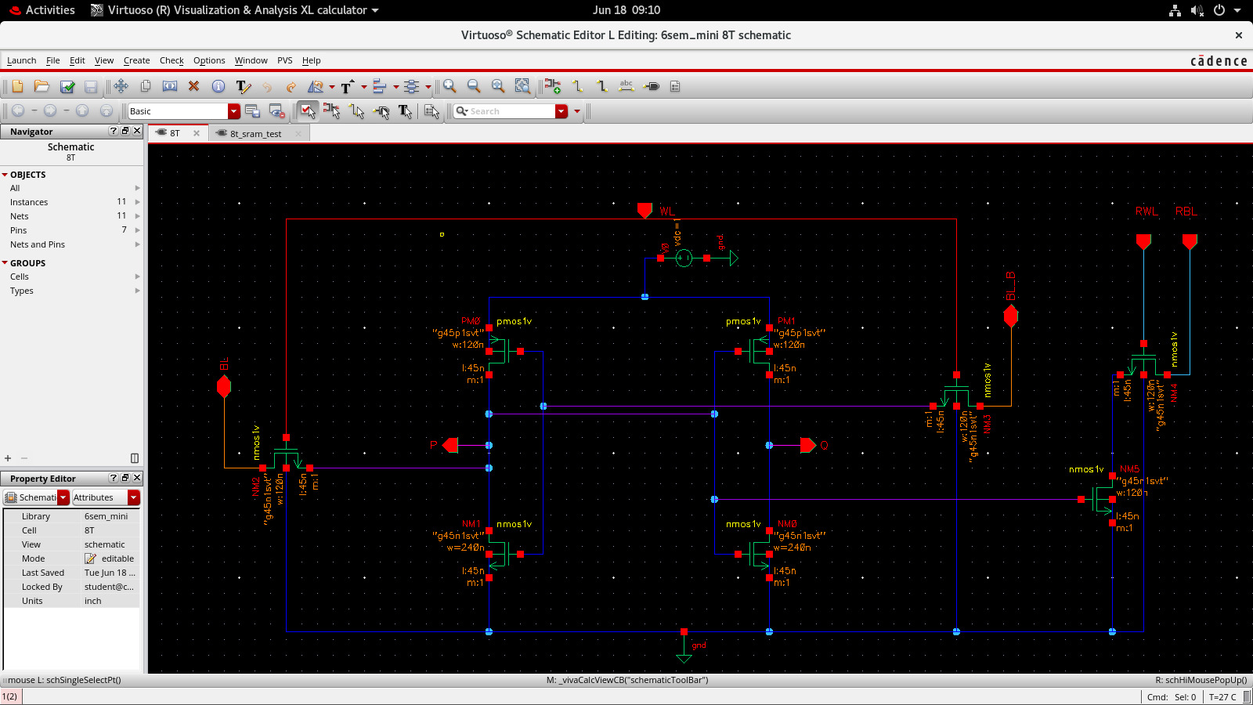
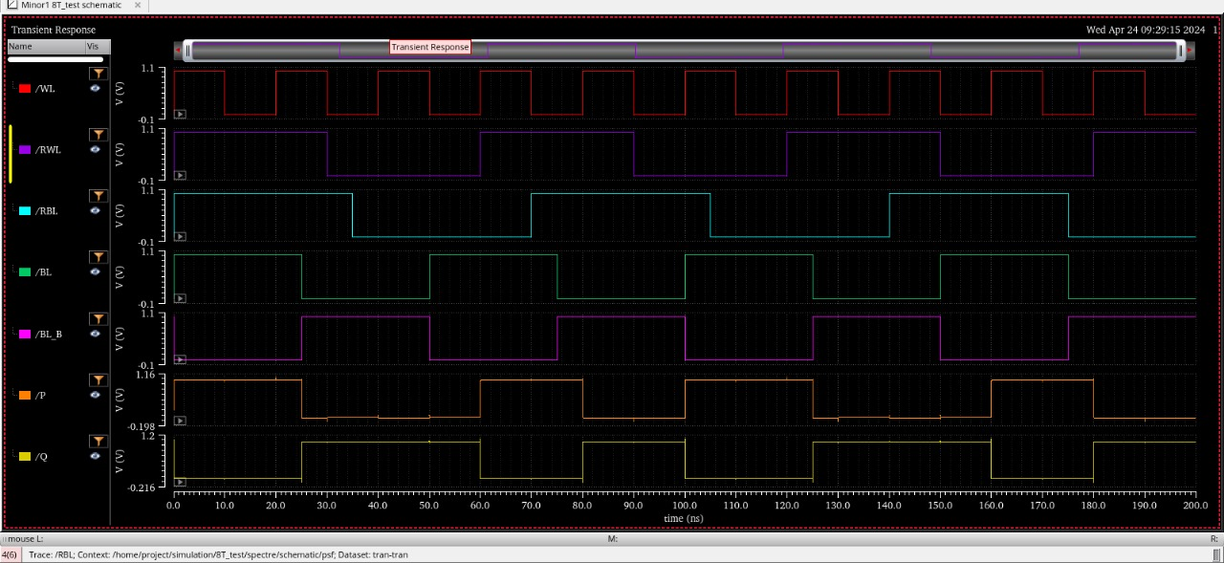
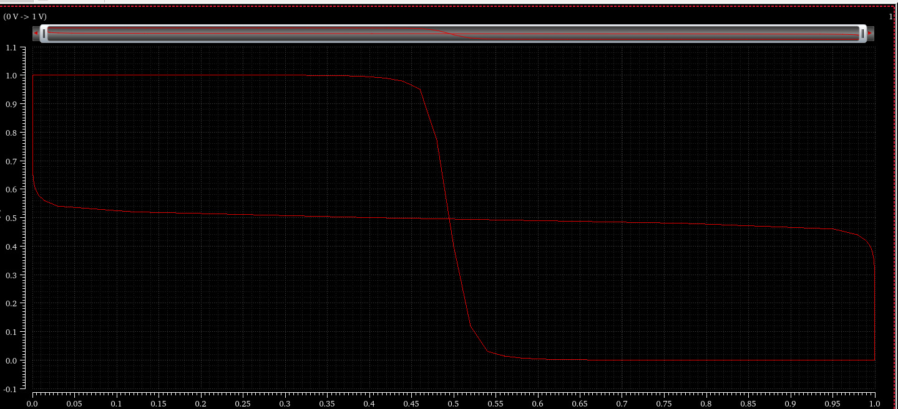
DESIGN AND OPTIMIZATION OF HIGH PERFORMANCE SRAM
Aleena Mulla ; Basavesh Patil ; Harsh Patil ; Pratik Patil
Under guidance of : Prof Ashwini Desai
Problem statement
Methodology
Results
The design and optimization of SRAM cells are critical for achieving low power consumption and high stability in modern electronic devices. Traditional 6T SRAM cells face challenges such as high leakage current and instability at lower voltages. The 8T SRAM architecture offers a potential solution, but its performance needs to be evaluated and optimized for practical applications.
Virtuoso Schematic editor
Design of Conventional 8T
Circuit simulations
Verification of functionality
Varying widths for optimizing
power analysis
Width (W/L) | Average power
All 120nm | 1.638 e-6 W
High skew | 2.247 e-6 W
Low skew | 1.642 e-6 W
Objectives
Significance of 8T SRAM Cell: The 8T SRAM cell is identified as a crucial component for achieving stable and efficient memory storage in electronic devices, addressing the limitations of 6T SRAM cell
Importance of Transistor-Level Optimizations: The project recognizes the significance of transistor-level optimizations to enhance the performance and efficiency of the 8T SRAM cell, emphasizing the fine-tuning of transistor dimensions to achieve optimal results.
Application in Reducing Power Consumption: The primary aim is to implement design and optimization techniques that substantially reduce the power consumption of the 8T SRAM cell
Parameters | Delay
Write 1 | Rising to falling | 35.01 e-9S
 | Falling to rising | 25.02e-9S
Read 0 | Rising to falling | 25.01e-9s
 | Falling to rising | 35.02e-9s
Results
Contributions
Conventional 8T SRAM cell
Optimization Through Transistor Width Variation:
Comprehensive Power Analysis Metrics
Read and Write Delay Calculation
Insights into Low-Power Digital Circuit Design
Empirical Evidence through Simulation Results
Optimization details
We are optimizing the 8T SRAM cell by varying the transistor channel width-to-length (W/L) ratio. This technique fine-tunes the switching behavior of the transistors, aiming to enhance performance metrics, minimize power dissipation, and improve Static Noise Margin (SNM) and delay.
Literature survey
The authors from the paper titled ” Area Optimization in 8T SRAM Cell for Low Power Consumption” A low power SRAM memory cell is presented. The power consumption is improved by varying the width & length of channels. SRAM cell is designed and simulated at 0.12μm technology. The design is implemented in CMOS technology. Power consumption and frequency of memory cell have been observed from simulation result
A Comparative Analysis of Improved 8T SRAM Cell With Different SRAM Cell design and implemented a low power, low delay and high SNM SRAM cell. also analyzed the power consumption and delay of improved 8T SRAM cell is less as compare to conventional 6T, 7T, 8T, 9T SRAM cell. The improved 8T SRAM cell is reducing the delay and increasing Static Noise Margin (in hold mode)
Conclusions
This project successfully explored the design and optimization of an 8T SRAM cell using 45nm technology in Cadence Virtuoso, focusing on enhancing performance and reducing power consumption. The conventional 8T SRAM cell was initially designed with a minimum transistor width of 120nm and thoroughly analyzed for stability and power efficiency. By varying the widths of pull-down and pass transistors to 240nm, significant insights were gained into the impact of transistor dimensions on overall power consumption.
Mini Project-2023-24

